Slide 1
Race Leys Infant School
New Reception Parent Information
14th June 2022

Slide 2
Welcome and introductions…

Slide 3
‘Learning Together we can Reach for the Stars’

Slide 4
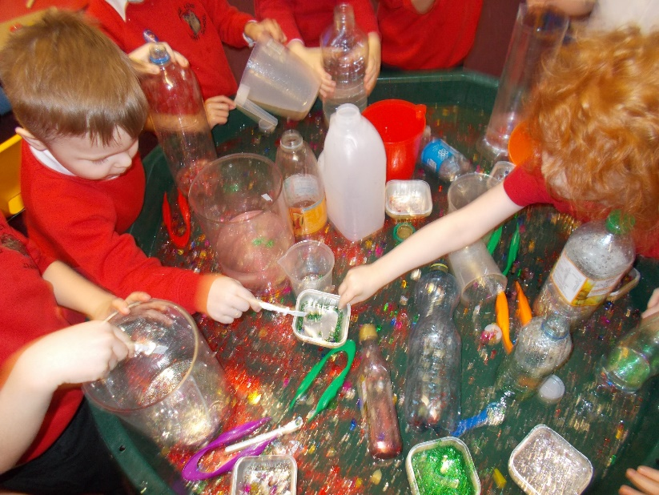
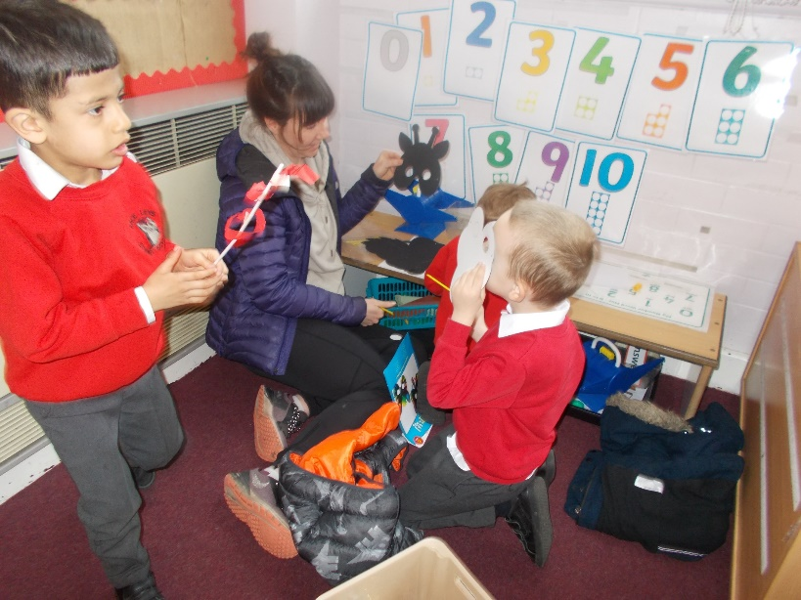
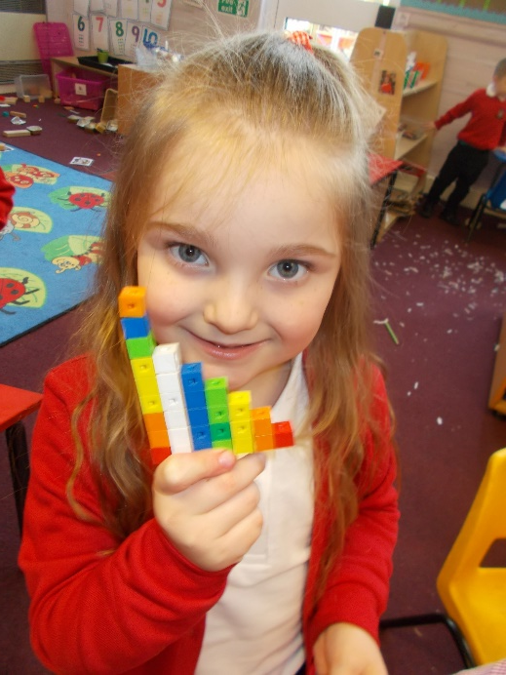
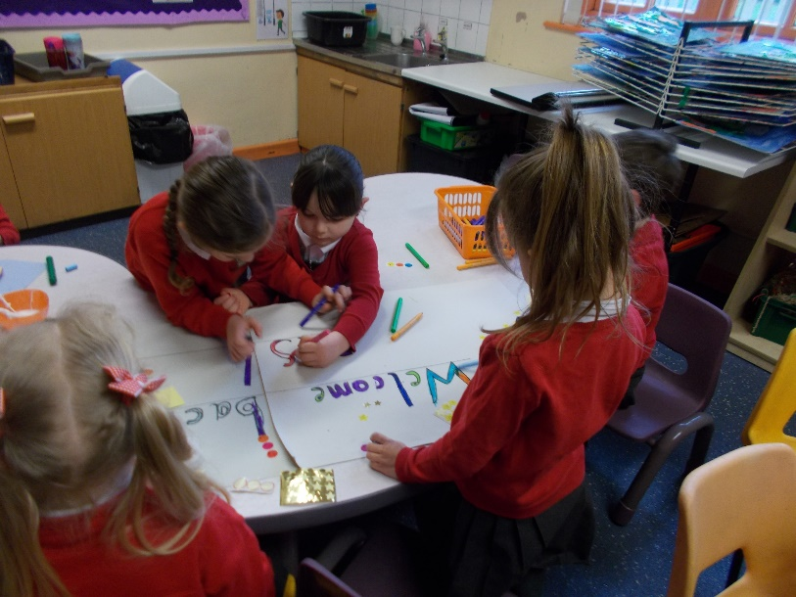
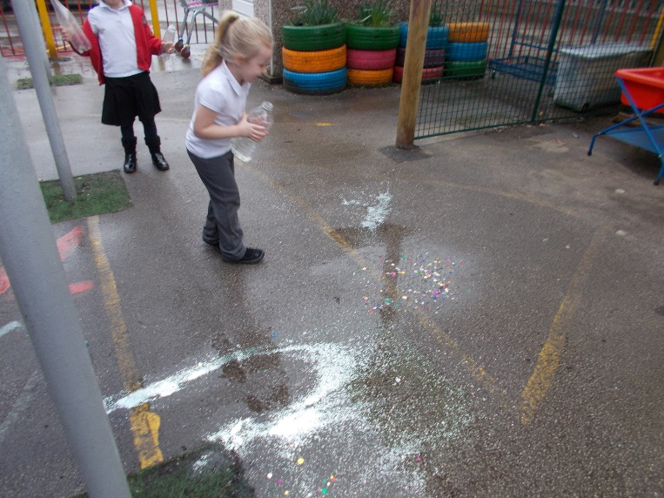
Race Leys Infants

Slide 5
Our Reception classes
We have 2 Reception classes.
Each has a teacher and a teaching assistant.
In September, school starts at 8.40am and finishes at 3.10pm.
The whole school has the same start and finish times.
The classes at Race Leys are named after the birds you will find if you walk around the lakes and ponds in Bedworth. The Reception classes are called Gosling and Cygnet.

Slide 6
September
Week Beginning 5th September:
Monday- Teacher Training Day
Tuesday- Reception Staff Training Day
Wednesday- Staggered start 8.40, 9.00, 9.20 (These times will be given to you once the classes have been allocated)
Thursday- All children in school full time: 8.40-3.10.

Slide 7
Early Years Foundation Stage
Reception continue with the same curriculum as Nursery.
The areas of learning are:
Communication and Language
Physical Development
Personal, Social and Emotional Development
Literacy
Mathematics
Understanding the World
Expressive Arts and Design

Slide 8
Phonics
We use Read Write Inc.
Children learn a sound a day.
Sounds are sent home to allow parents to support.
You will also receive links to online phonic videos to support with reading at home.
We are keen to share how we teach this and how you can help at home so will invite you to a phonics meeting in September.

Slide 9
Reading
Children will have a wordless book at first. This develops story language, prediction and sequencing.
Children will have a book with words once they have learnt some sounds.

Slide 10
Number
By the end of the year, we aim for the children to be confident working with numbers to 20.
This doesn’t mean just saying the numbers in order but understanding the numbers thoroughly, such as 8 is the same as double 4.
Within the year the children will learn to be inquisitive about numbers, shapes and patterns.

Slide 11
Writing
At the start of the year the children will continue to practice writing their names.
Alongside their phonics learning, the children will begin to use the sounds in words.
The children will then orally develop the skills to create captions and sentences before they begin to write them.
If your child can start to write and recognise their name before they start school that would be helpful.

Slide 12
Writing
We will be using elements of The Write Stuff, a programme developed by Jane Considine, to promote the children’s vocabulary and love for Writing and stories.
Oral rehearsal is a vital skill, so speaking and listening activities at home are a great way to promote this.
We will give you more information about The Write Stuff later on in the year.

Slide 13
Continuous Provision
Much of our learning in Reception will be happening in our soon to be updated environment.
The children will have access to a range of activities designed to promote independence and active learning for all.
Children’s interests will be included throughout our learning environment.

Slide 14
Uniform
You can buy uniform from the school. This is only available in the mornings.
The uniform list is in the school prospectus.
Your child will also need a school book bag (no rucksacks) and a drinks bottle.
PE kits- Plain white t- shirt, black shorts/joggers and pumps/trainers- currently the children wear their kit on PE days.
PLEASE NAME EVERYTHING!

Slide 15
Attendance/Holidays
Regular attendance helps your child reach their full potential.
National attendance expectations are 95%.
Please phone in the morning if your child will be absent.
We cannot authorise holidays in term time unless there are exceptional circumstances.

Slide 16
After school provision
Staff and external providers usually provide some after-school clubs (well-being, Lego, sports etc). These start in the Spring term for Reception.
Happy Tykes is our on-site before and after school club- this is not controlled by the school.
Breakfast club starts at 7.30am and after school club finishes at 6.00pm.
We also have a book shop on the school site.

Slide 17
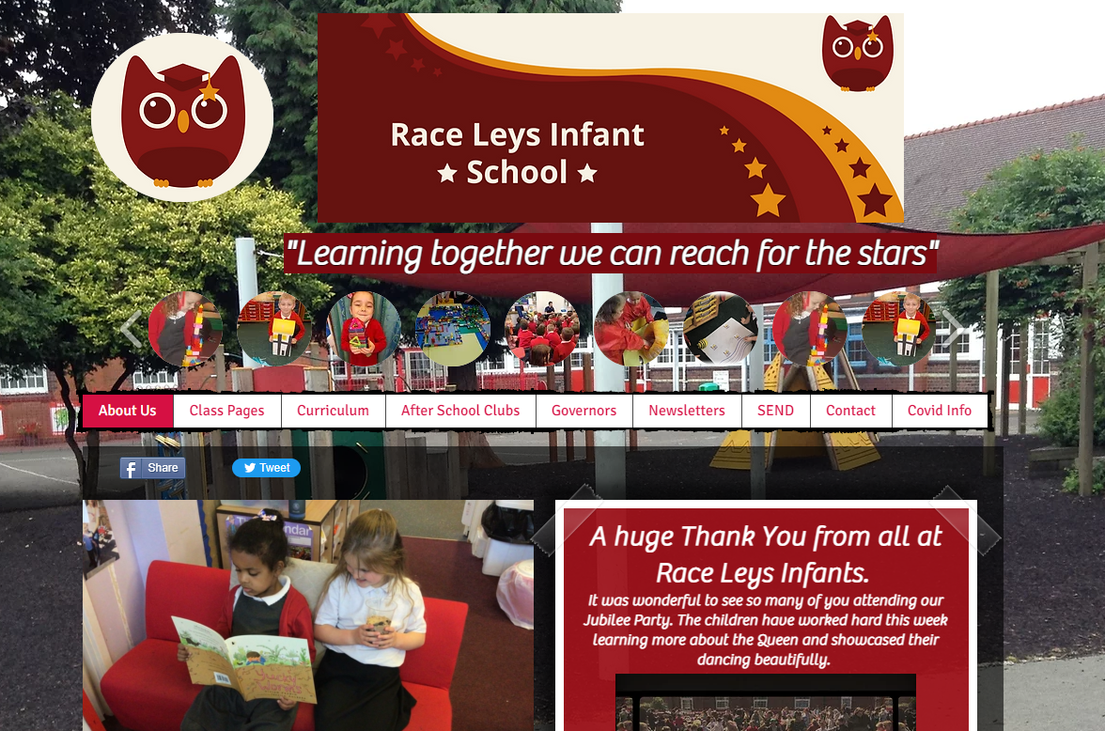
Website

Slide 18
School meals
Each child gets a free school meal.
They will get a choice of a hot or cold meal in the morning and we order their meal. There are three hot options available each day, one of which is a jacket potato.
Meals are cooked on-site.
They also get a piece of fruit as a snack every morning.
We also provide a hot buttered bagel first thing to settle the children.

Slide 19
Pupil Premium
If you receive any benefits, you are able to apply for Registered Free School Meals. This can be done on the following website:
www.warwickshire.gov.uk/freeschoolmeals
This is a payment for the school, which helps us provide extra support in school for your child.
If you are unsure, please ask Mrs Lamley in the school office. We can help you apply for this.

Slide 20
Learning Mentor
We have a Learning Mentor, Mrs Johnson.
Mrs Johnson can support families with topics such as sleeping, toileting and behaviour. Please contact the school office if you would like to speak to Mrs Johnson.
She will also work with small groups and individuals in school.

Slide 21
SEN
Some of our children have additional needs.
Mrs Gurr is our Inclusion Leader.
Please contact the school office if you would like to speak to Mrs Gurr.

Slide 22
What can I do to help my child prepare for school?
Sing nursery rhymes
Read a story to them everyday and talk about books.
Count every day, both reciting numbers in order and counting small amounts of everyday items.
Play games, such as board games, card games, I-Spy.
Play with things like Lego or playdough to help with hand strength.
Practise independence, e.g. getting dressed

Slide 23
Paperwork
Please ensure all paperwork is sent back to the school office.
Please ensure all emergency details are up to date.
If there is a change to the usual pick up arrangements, please let your child’s class teacher or the school office know.

Slide 24
Classes
We will let you know your child’s class following the induction day. We are going to see how the children interact as well as our notes from Nurseries before we put them into their new classes.

Slide 25
Any questions?

Slide 26
Let’s go and see Reception!

